Slide 1
SCHEDULES & Other Information
Power school & contra costa college

Slide 2
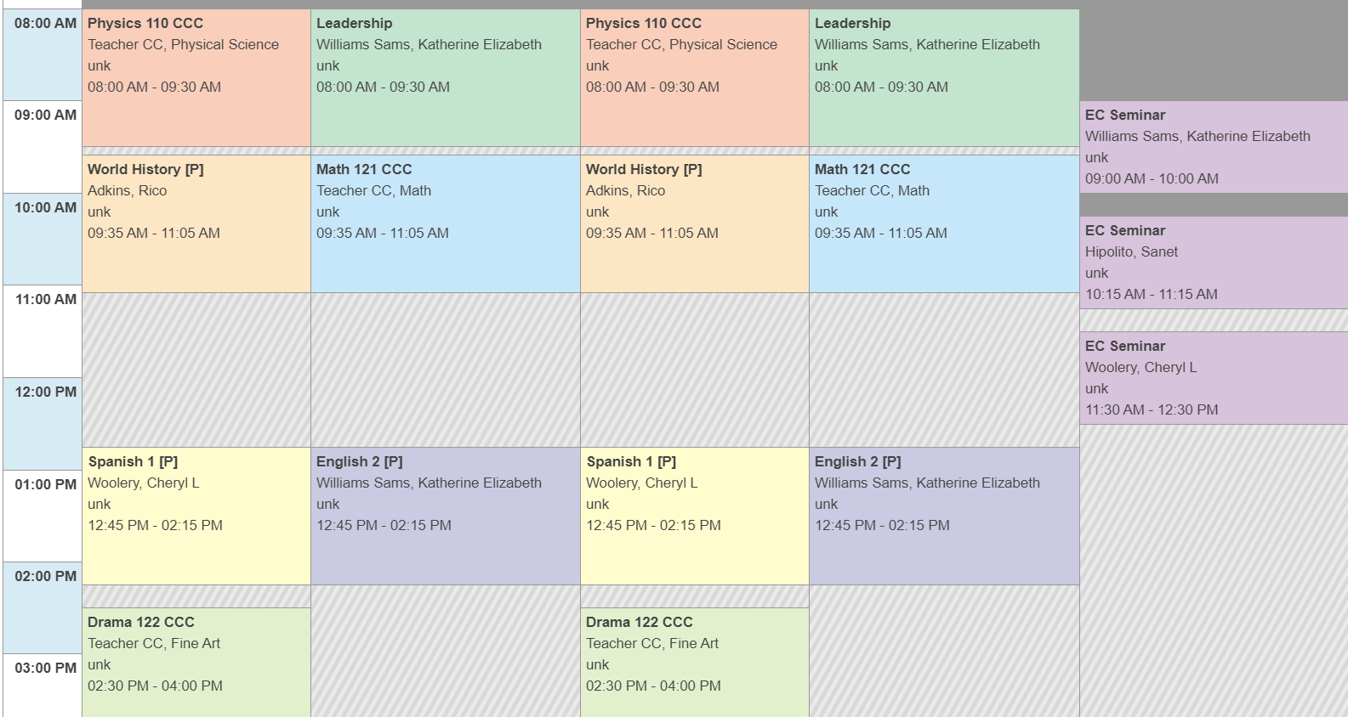
Power School Schedules
Notes:
Ms. Moore and I manually input every student’s schedule. We have block periods; usually 1st through 5th period. There are going to be some classes that start before that; Zero period and some that go into 6th period. Those classes are typically CCC college classes.

Slide 3
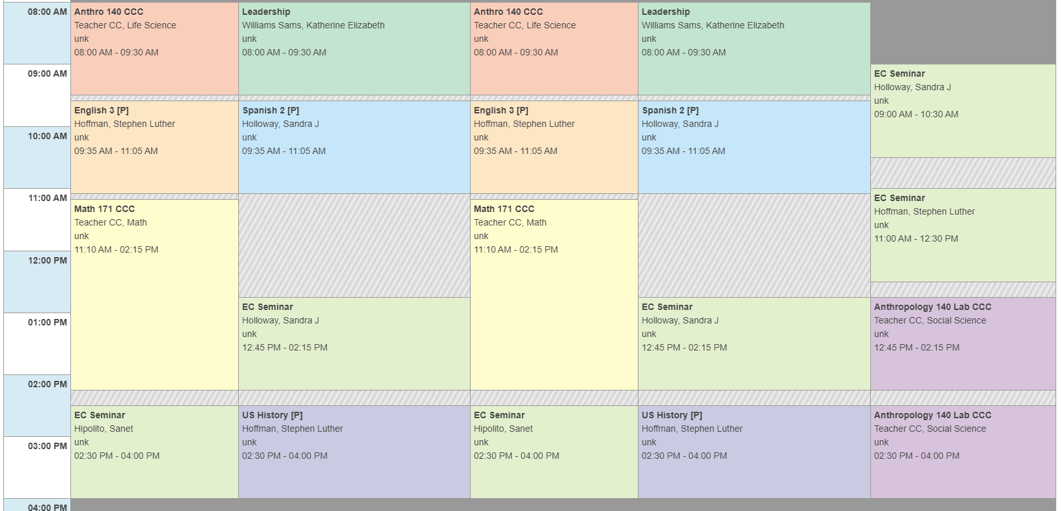
Power School Schedule
Continued
Notes:
Please notice on this student’s schedule they have a Friday Anthropology Lab after they have Friday EC Sems with MCHS. Because we aren’t able to create blocks that match CCC’s class times we have to some times put it in two separate blocks but it’s only because Power School won’t always let us create time blocks the way we do for high school classes. You’ll notice that Math 171 shows for two periods; however, please make sure you are checking your CCC class syllabus to see if there are specific meeting dates and times. This Math 171 class may not actually go until 2:15 but we have no way of creating time blocks, as I mentioned.

Slide 4
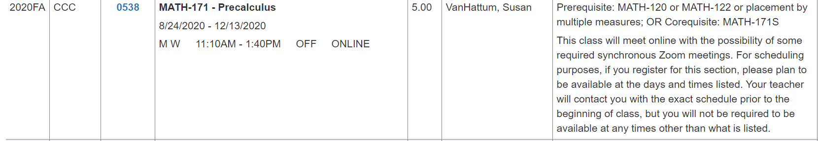
CCC Course Description
& Course Schedule
Notes:
As I showed you in the previous slide, Math 171 takes up two period blocks (on Power School) however the class is only from 11:10am to 1:40pm. On Power School you will see it goes until 2:15pm. This means the class ends at 1:40pm. Please also notice that in the box to the far right it explains the class has “synchronous Zoom meetings”. That means the professor expects students to be in the Zoom meeting during those days and times. For this class it’s MW 11:10am to 1:40pm.

Slide 5
CCC Classes
You will need to make sure to follow any instructions the professors give you about class meeting dates and times.
You should be checking your college email (it ends with @insite.4cd.edu) daily, since CCC professors will use that to contact you.
We created your schedules based on what we know about the class meeting dates and times however; if things change, like the meeting times, we have no way of knowing unless you tell us.
Notes:
If you have a class that doesn’t show meeting days and times (on the CCC Course Schedule) meaning it doesn’t show that Synchronous Zoom meeting line, (mentioned in the previous slide) I’ve created it in Power School so that you remember to check Canvas or how ever the professor posts assignments. There is a HED 120 course that some of you are in (10th graders only) that does not have set days and times to meet but I have to show it on your Power School schedule. Please take that time to work on any assignments or readings you need to complete.

Slide 6
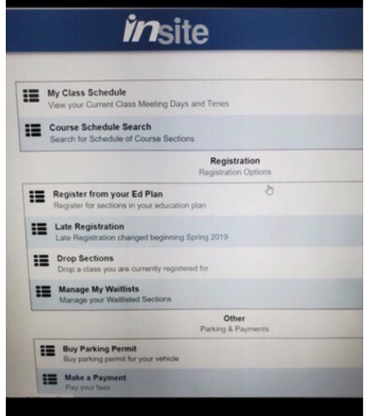
How to find your CCC Fall 2020 Schedule on Insite Portal
Notes:
I don’t have access to the CCC systems like Insite Portal but after you login, you will see a screen with these menu options or possibly different colored tiles. There should be an option to locate “My Class Schedule”. The next slide gives more details about how to find your Fall 2020 Schedule.

Slide 7
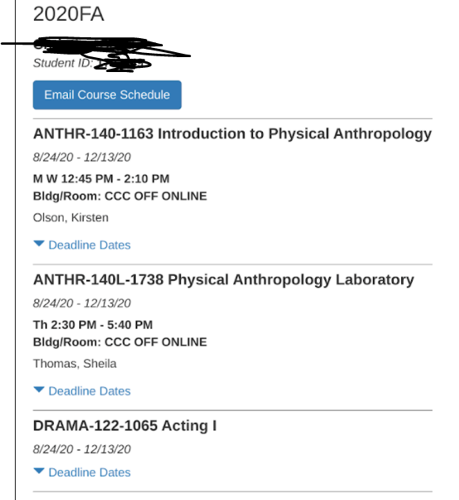
CCC Fall 2020 Schedule Example
Notes:
This is what you should see once you login to your Insite Portal and select My Class Schedule. You may need to select Fall 2020 and then this type of schedule should appear.

Slide 8
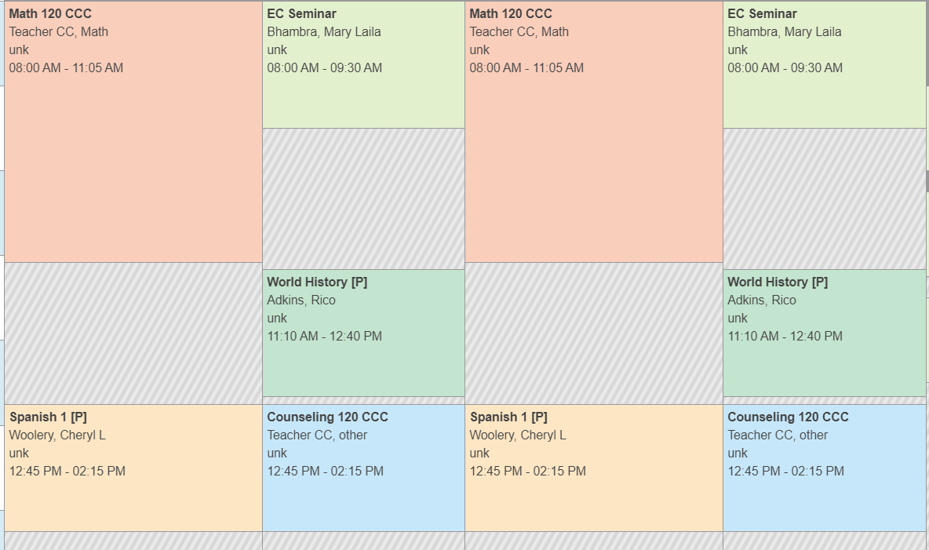
MCHS Classes versus
CCC Classes
Notes:
All your MCHS high school classes will show a MCHS teacher’s name. In the picture you see Math 120 CCC Teacher CC means its taught by a CCC college professor. EC Seminar you can see shows Ms. Bhambra as the MCHS teacher. World History is Mr. Adkins and Spanish 1 is Ms. Woolery. Just a quick note; EC Seminars are NOT subject specific. You will be expected to attend and work on any homework or assignments from other classes. We want you to really use that time to get help if you can, or complete work.

Slide 9
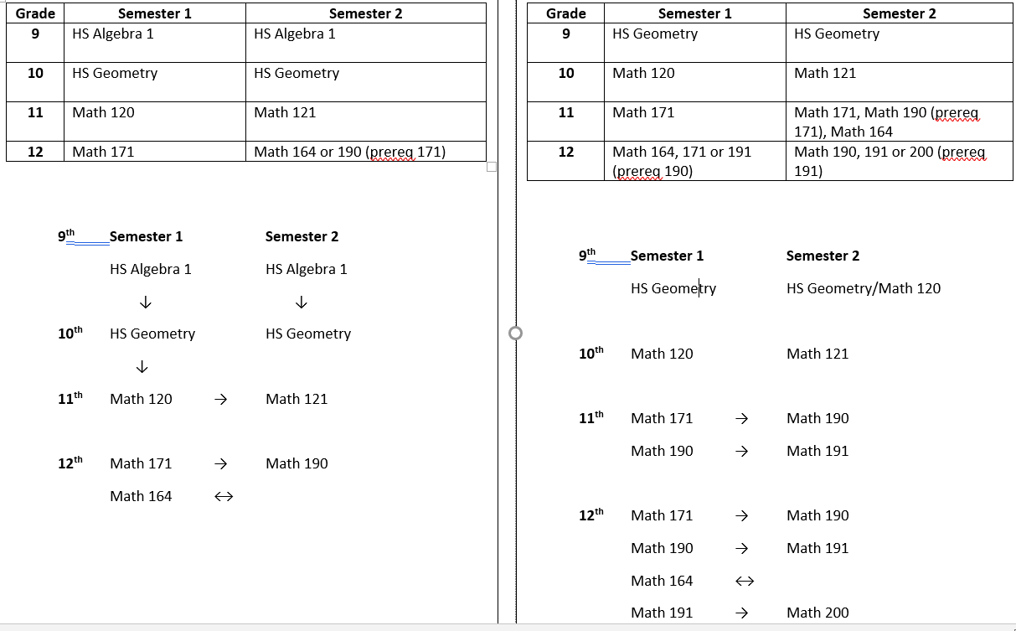
MCHS Math Sequence
Notes:
I have been getting some emails from students asking me if they are in the correct high school math course because it says Ms. Obradovic or Ms. Hipolito. Please understand this school year is different. One of the other math teachers, Ms. Love retired so we changed the way math classes are divided among Ms. O and Ms. Hipolito. Sophomores, I know last year was Ms. O taught 9th grade Geometry and Ms. Hipolito taught 10th grade Geometry. That is not the case this year. None of you will be behind if you haven’t started taking college math classes during your sophomore year. Please understand you will be taking a different college math class every semester once you get to that point. College math is rigorous since they are 16 week courses, whereas high school math classes are year long.

Slide 10
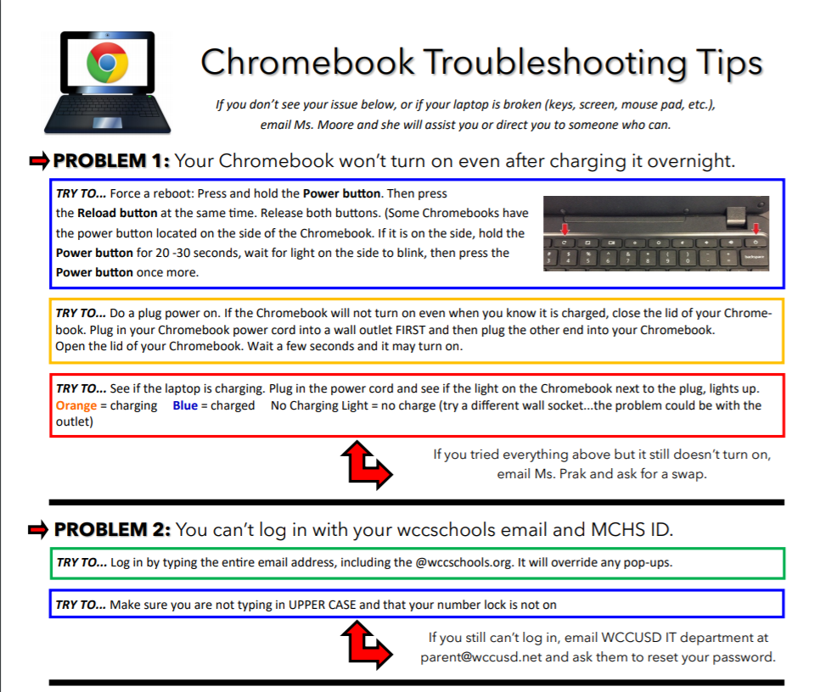
Chromebook Tips
Notes:
This is a one pager, but I couldn’t fit it on the slide. Ms. Prak will be emailing this out to all students and parents. Please read it slowly and carefully. We want to make sure any issues with Chromebooks are fixed but we need you to try these steps first before emailing Ms. Prak or the IT department.

Slide 11
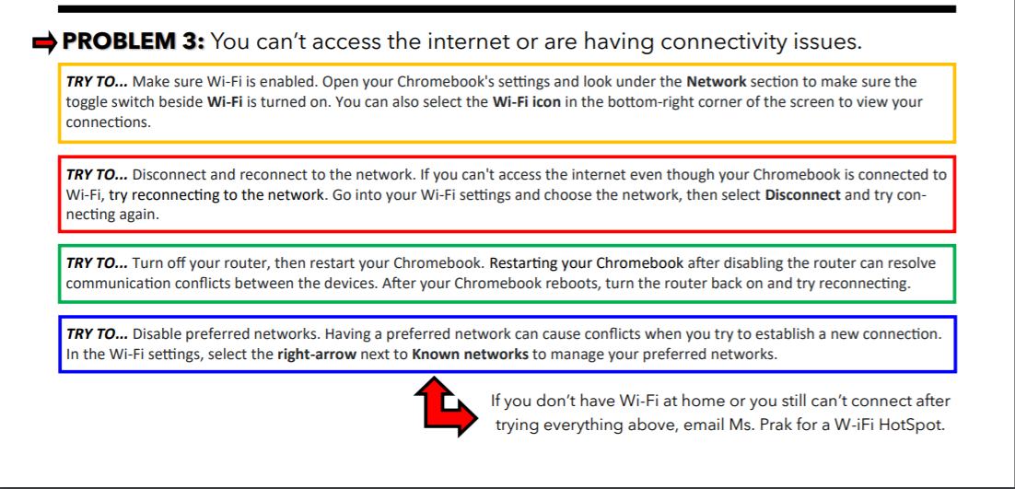
Chromebook Tips continued
Notes:
Again, when Ms. Prak emails this out it will be one page. It is already on our MCHS website.

